Slide 1
Offline HEARTS game for android
By Márton borbényi and viktor tóth

Slide 2
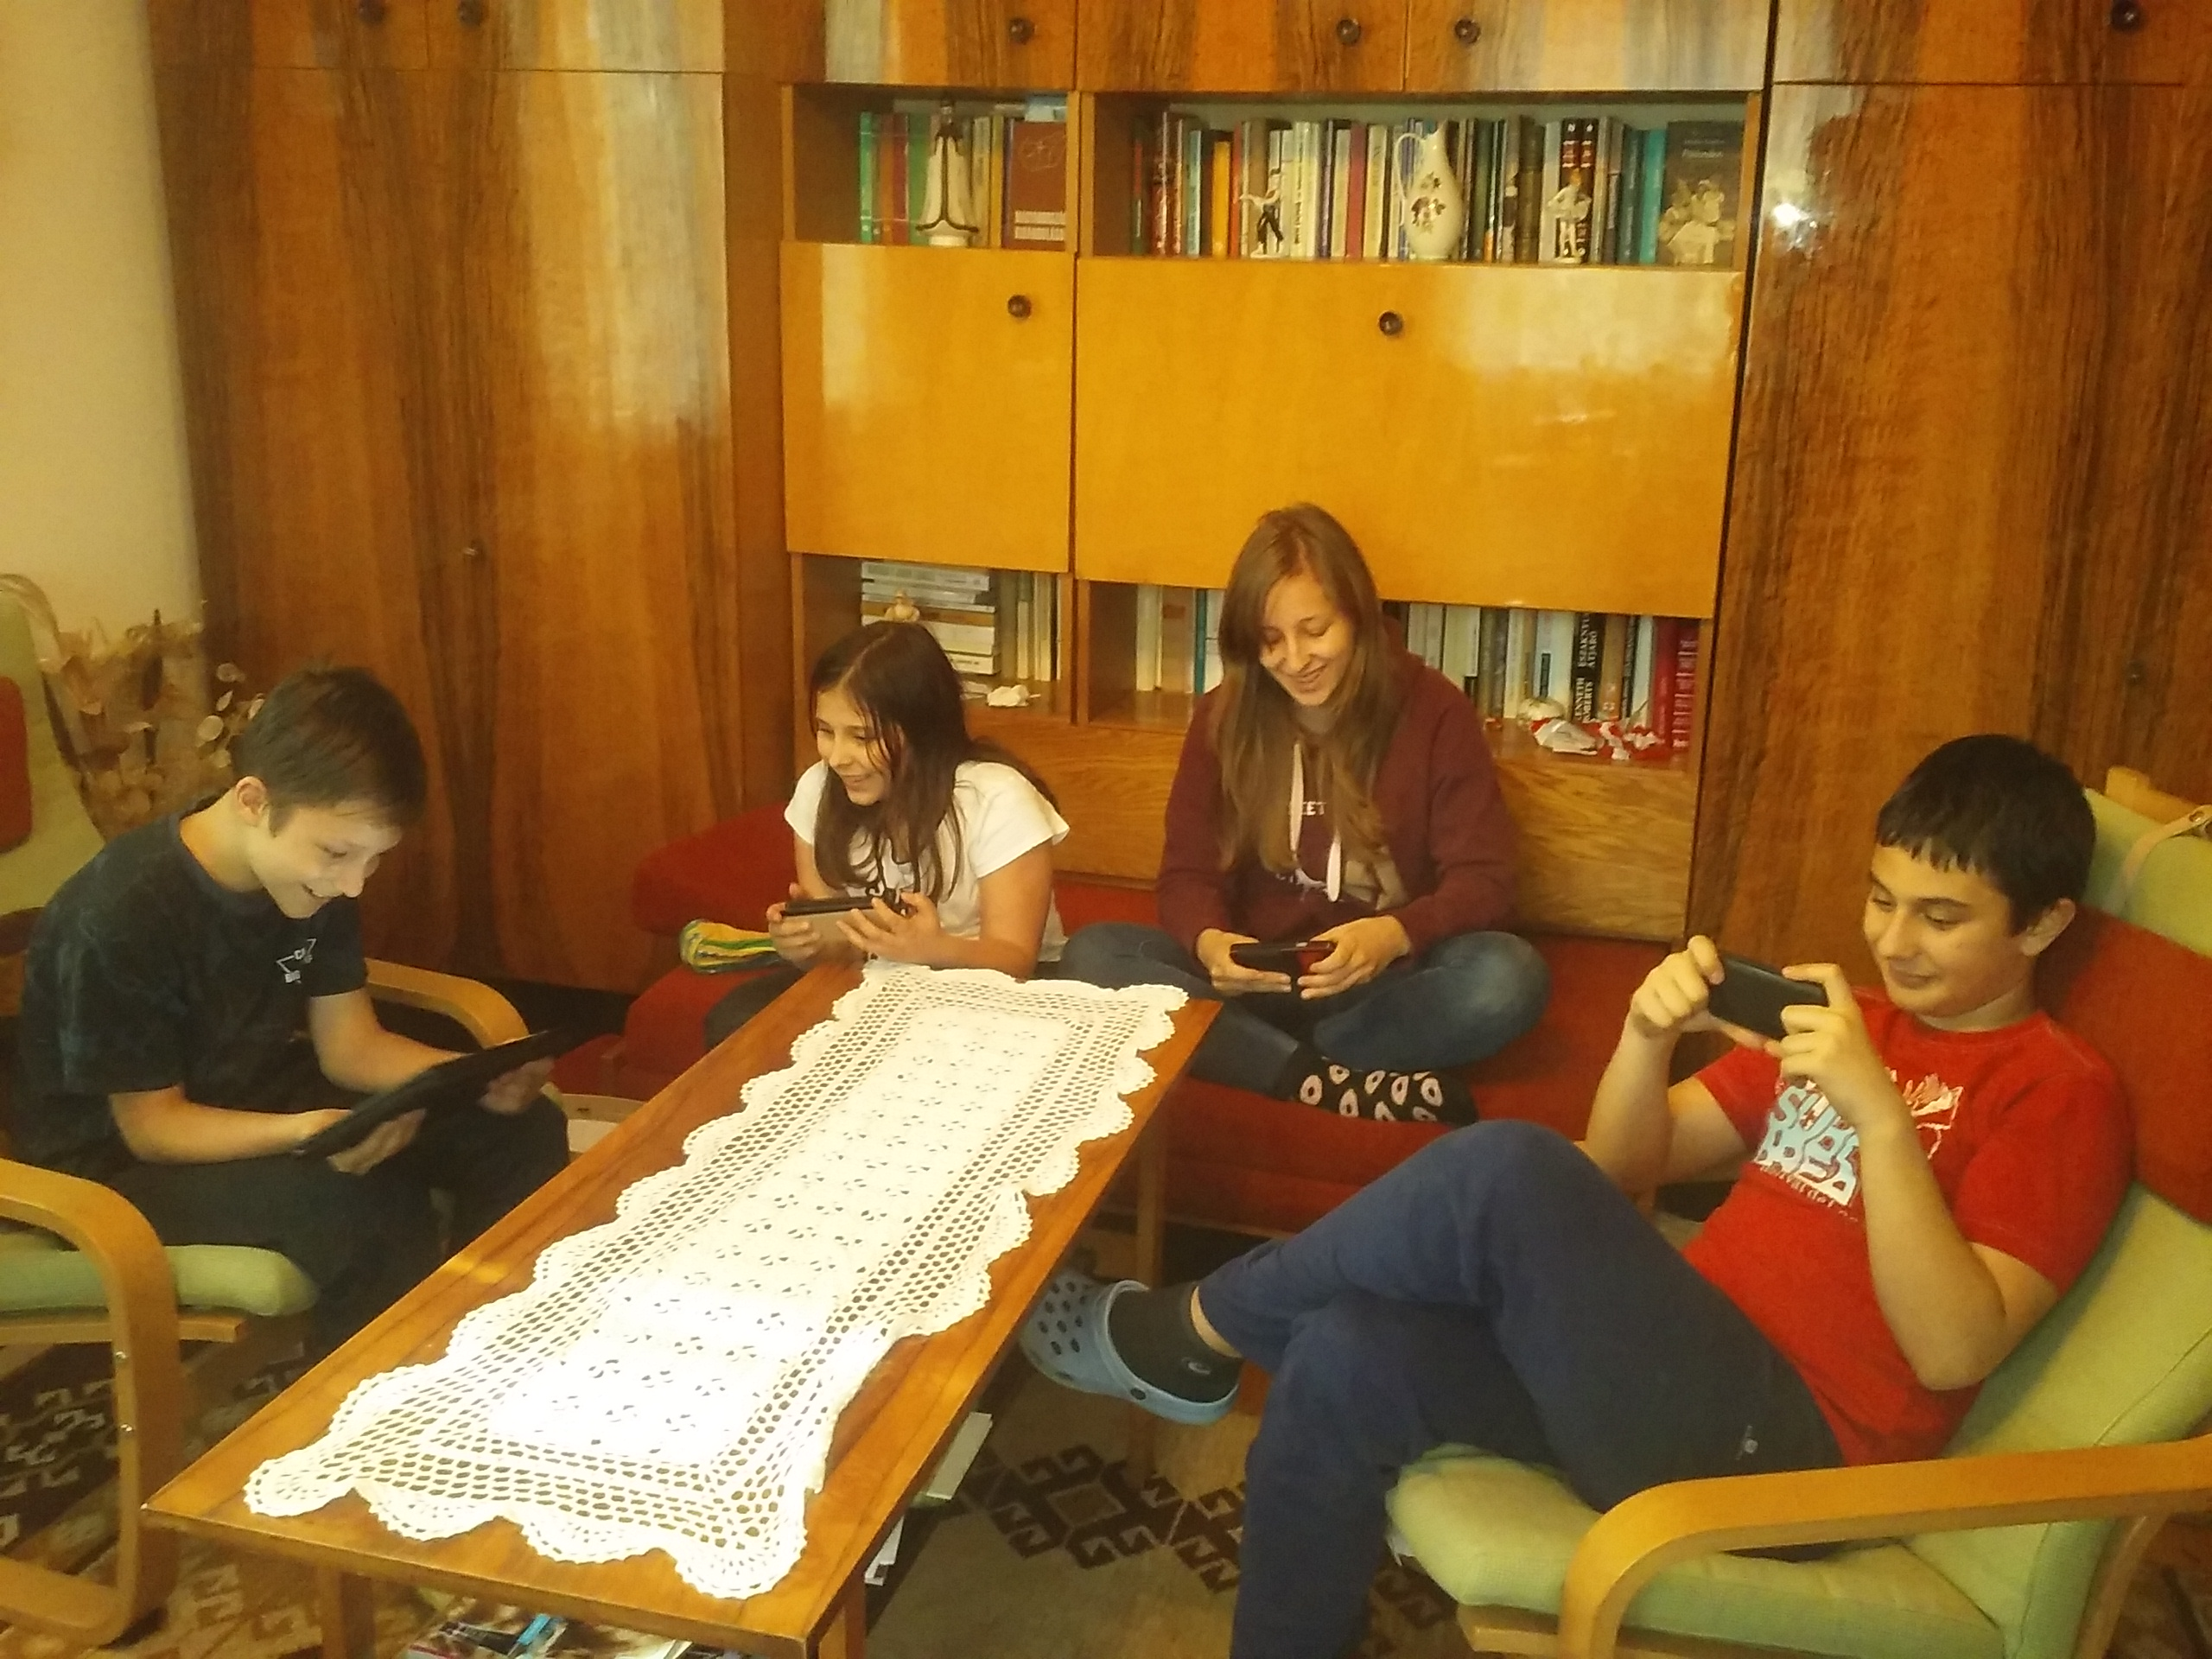
The Goal of the project
Creating a multiplayer game which doesn’t require Internet connection
A social experience
Play anywhere anytime

Slide 3
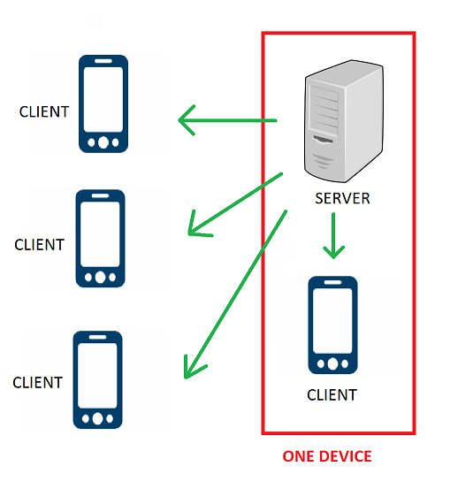
Main concept
A wifi-network is shared by a device
Other devices connect to this network
One device functions as a server, the others are clients
To achieve this, we developed a brand new network protocol
Currently supports Android 4.2 and above (88% of Android devices)

Slide 4

Future plans
GUI improvements, animations
Supporting IOS and Windows Phone
Implementing player statistics and Elo rating system
Customization and cosmetics
Introducing virtual money

Slide 5

Future plans
Developing more card games
With Internet connection playable across the World
Implementing AI-players
Optimization

Slide 6

Business model
Free-to-play
Income from advertisements
Premium version, ad-free
Virtual money for purchase

Slide 7
Thank you for your attention

